Slide 1
Examination of Case ‘Suffolk’
Scenario
Evidence Items
Further leads
Observations
Notes:
This presentation covers the scenario of the case examined, the key evidence items found, further leads and final observations.

Slide 2
Scenario
Computer User: Richie Beans.
Evidence of distributing Ecstasy in York.
Great lengths have been taken to make certain files very difficult to locate.
Hard drive analysed using FTK, EnCase & Autopsy.
Notes:
The evidence items collected were found on a copy of a hard drive running Windows XP (SP3 x86 NTFS), used by an individual with the profile name Richie Beans.
The hard drive contains suspect files, which I will cover individually, containing evidence of the distribution of Ecstasy in York.
A range of techniques have been used to hide these files, including Encryption, Steganography, Bad File Signatures and Alternate Data Streams.
The hard drive was analysed using FTK 1.8.1, EnCase 7 & Autopsy 3.1.1.

Slide 3
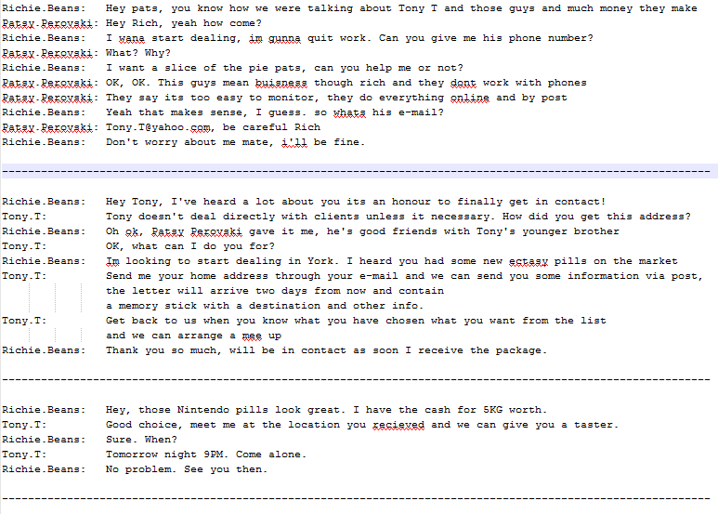
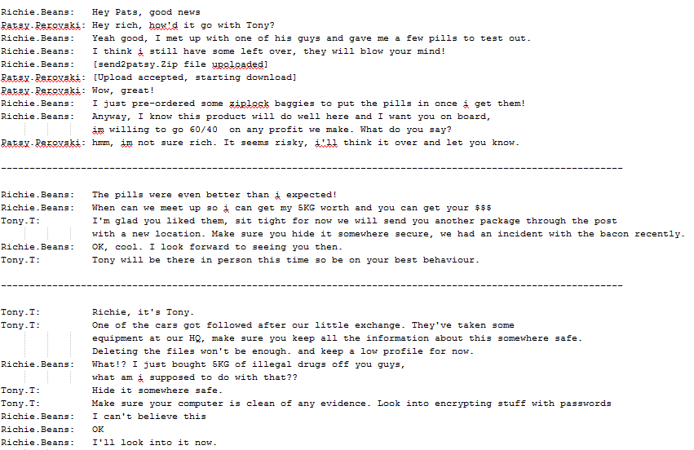
Item 01 - chat1.txt, chat2.txt, chat3.txt, chat4.txt, chat5a.txt, chat5b.txt
C:/Documents and Settings/Administrator/My Documents/yahoo/IM/Chat logs/
Notes:
The first evidence item is a set of six chat logs. I have extracted the relative messages to the case in the next couple of slides.

Slide 4
Item 01(a) - chat1.txt, chat2.txt, chat3.txt
Richie.Beans: I wana start dealing, im gunna quit work. Can you give me his phone number?
Richie.Beans: Im looking to start dealing in York. I heard you had some new ectasy pills on the market
Tony.T: Send me your home address through your e-mail and we can send you some information via post, the letter will arrive two days from now and contain a memory stick with a destination and other info.
Tony.T: Get back to us when you know what you have chosen what you want from the list and we can arrange a mee up
Richie.Beans: Hey, those Nintendo pills look great. I have the cash for 5KG worth.
Tony.T: Tommorow night, 9PM. Come alone.
C:/Documents and Settings/Administrator/My Documents/yahoo/IM/Chat logs/
Notes:
In chat1 Richie states that he wants to quit his job and start dealing to make money. The user Patsy gives him the email address of a user named Tony T.
In chat2 Richie contacts Tony stating he wants to start dealing in York and has heard he has ecstasy pills. He’s told he’ll be posted more details.
In chat3 Richie contacts Tony again, stating his interest to purchase 5kg of ‘Nintendo Pills’ and is asked to meet.

Slide 5
Item 01(b) - chat4.txt, chat5a.txt, chat5b.txt
Richie.Beans: Yeah good, I met up with one of his guys and gave me a few pills to test out.
Richie.Beans: [send2patsy.Zip file upoloaded]
Richie.Beans: I just pre-ordered some ziplock baggies to put the pills in once i get them!
Richie.Beans: When can we meet up so i can get my 5KG worth and you can get your $$$
Tony.T: I'm glad you liked them, sit tight for now we will send you another package through the post with a new location. Make sure you hide it somewhere secure, we had an incident with the bacon recently.
Tony.T: Tony will be there in person this time so be on your best behaviour.
Tony.T: One of the cars got followed after our little exchange. They've taken some equipment at our HQ, make sure you keep all the information about this somewhere safe. Deleting the files won't be enough. and keep a low profile for now.
Richie.Beans: What!? I just bought 5KG of illegal drugs off you guys, what am i supposed to do with that??
Tony.T: Hide it somewhere safe. Make sure your computer is clean of any evidence. Look into encrypting stuff with passwords
C:/Documents and Settings/Administrator/My Documents/yahoo/IM/Chat logs/
Notes:
In chat4 Richie confirms he received a sample of the pills and sends Patsy a file. He also expresses his intention to get more by pre-ordering zip-lock bags to hold them.
In chat5a Richie contacts Tony and arranges to collect 5kg of the pills.
In chat5b Tony contacts Richie informing him that one of his cars was followed and equipment was taken and that Richie should secure any incriminating evidence. Richie also confirms that he collected 5kg of illegal drugs.

Slide 6
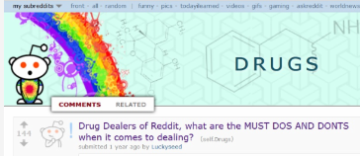
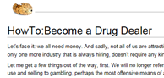
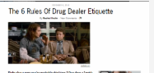
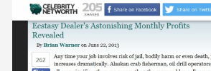
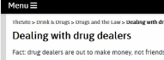
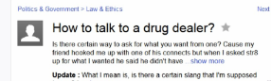
Item 02 - drukqs.jpg
User’s internet history.
Six of many examples.
Strong link with item 01.
C:/Documents and Settings/Administrator/ Internet History/
Notes:
Item 02 is a collection of six examples of the user’s internet history found on the hard drive.
There are many more examples related to drugs, dealing drugs and how to talk to drug dealers.
This evidence appears to form connections to the previous chat logs.

Slide 7
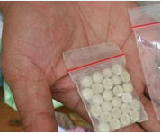
Item 03 - send2patsy.zip
Sent to Patsy in chat4.txt
Richie.Beans: Yeah good, I met up with one of his guys and gave me a few pills to test out.
Richie.Beans: [send2patsy.Zip file upoloaded]
Found using keyword search.
C:/Documents and Settings/NetworkService/
Notes:
Item 3 is the file Richie sent to Patsy in chat4. It is a zip file that containing this image.
The file was found using a keyword search within EnCase.

Slide 8
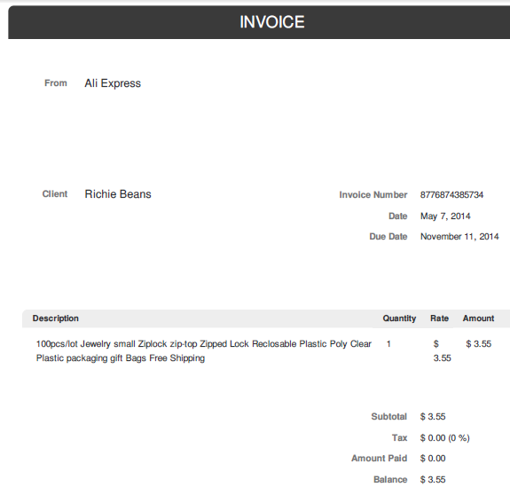
Item 04 - Dc3.bmp
Mentioned in chat4.txt
Richie.Beans: I just pre-ordered some ziplock baggies to put the pills in once i get them!
Invoice for purchase of 100 ziplock bags.
File given bad signature.
C:/RECYCLER/S-1-5-21-1177238915-790525478-839522115-500/
Notes:
Item 4 was also referred to in chat4. It is an invoice for 100 zip lock bags.
The item was found when looking through files with bad signatures. The file did not display correctly and EnCase stated it was a pdf, not a bmp image.
After exporting the file and changing the extension, this invoice was recovered.

Slide 9
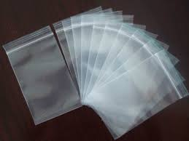
Item 05 - bags.jpg
Link to Item 03.
Stored in the Administrators pictures folder.
Found looking through images on the hard drive.
C:/Documents and Settings/Administrator/My Pictures/
Notes:
This item shows some zip locked bags which match the description in the previous invoice.
The photo was found in the administrator’s picture folder when looking through images stored on the hard drive in EnCase.

Slide 10
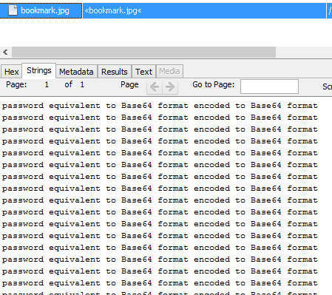
Item 06 - bookmark.jpg
File given bad signature.
Found in the user’s favourites folder.
Password in base64 format somewhere on hard drive.
C:/Documents and Settings/All Users/ Favorites/
Notes:
Item 6 has had its file extension changed in the same way as item 04 and was found using the same method.
This time the extension was changed to make the file appear to be a jpg image. However, when viewing the file in EnCase it can clearly be viewed as a text file.
The file contains the same line over and over, hinting that a password is held somewhere on the hard drive, but has been encoded using base64.

Slide 11
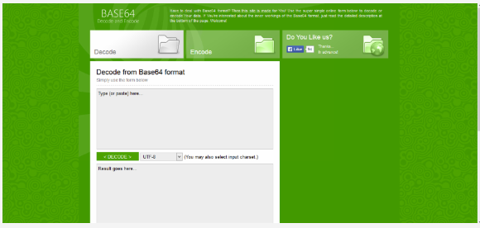
Item 07 - bass.png
Found in the user’s internet history.
Shows the method likely used to encode the password.
C:/Documents and Settings/Administrator/ Internet History/
Notes:
This item was found when looking through the user’s internet history.
It shows a web page that can be used to encode a plain text string using base64.
It is likely this website was used to encode the password mentioned in item 06.

Slide 12
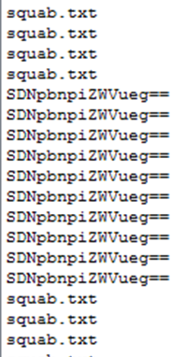
Item 08 - squab.txt:hidden.txt
Found in the user’s favourites folder
Hidden using alternate data streams.
Contains a base64 encoded string, repeated a number of times.
Decodes to ‘H3inzbeenz’’
C:/Documents and Settings/All Users/ Favorites/
Notes:
Item 08 was found when looking through the user’s favourite folder. The file squab.txt appeared as a blank text file, which seemed suspicious.
After running the file carver in EnCase the hidden file hidden.txt was found inside squab.txt, likely achieved using alternate data streams.
The hidden file contains an encoded string, which when decoded using the website from the previous item gives the plaintext password shown.

Slide 13
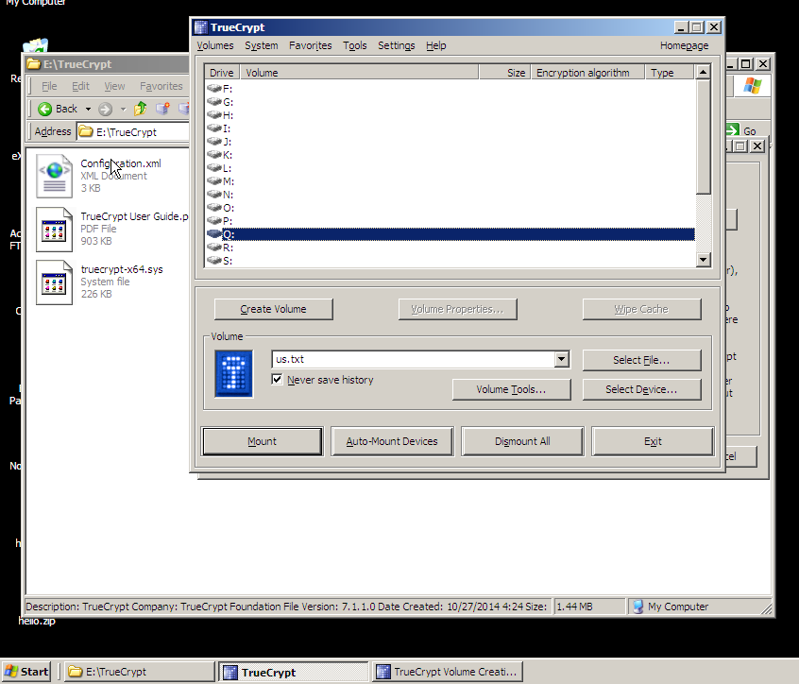
Item 09 - sceengrabber.png
Screenshot of TrueCrypt folder.
Container file displayed as ‘us.txt’
Suggests files have been hidden inside a TrueCrypt virtual disk.
Found looking through images on the hard drive.
C:/Documents and Settings/Administrator/My Pictures/
Notes:
Item 09 is a screenshot taken by the user showing that TrueCrypt was installed on the computer and the container used was named ‘us.txt’.
TrueCrypt is a piece of software that can create a virtual encrypted disk within a file. This means that anything stored within the TrueCrypt container cannot be accessed unless TrueCrypt is installed, the container is selected and the correct password is entered.
This suggests further files were hidden on the hard drive.

Slide 14
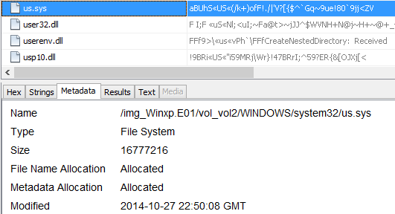
Item 10 - us.sys
Found using keyword search.
Large file size, multiple of 512.
Seemingly random data.
Password ‘H3inzbeenz’ unlocked container successfully.
C:/WINDOWS/system32/
Notes:
The TrueCrypt container was found using a keyword search. Us.txt did not exist on the hard drive, but us.sys was the closest match.
The file is large and is divisible by 512 which is an indicator of a TrueCrypt container.
It also appears to contain completely random characters, making the file likely to be encrypted.
I exported the file from EnCase and loaded it into TrueCrypt. I then used the password found in item 8 which revealed a folder containing 3 files.

Slide 15
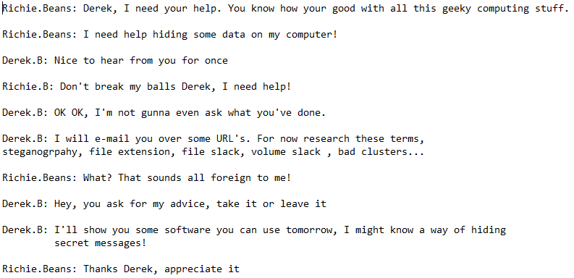
Item 11 - chat5c.txt
C:/WINDOWS/system32/us.sys/
Notes:
This is the first file found within the TrueCrypt container. It is a chat log between Richie and a new user named Derek B.
Derek appears to be knowledgeable in computer security and sends Richie methods of hiding files on his computer.
Key terms such as Steganography, File Extension, File Slack, Volume Slack and bad clusters are mentioned.

Slide 16
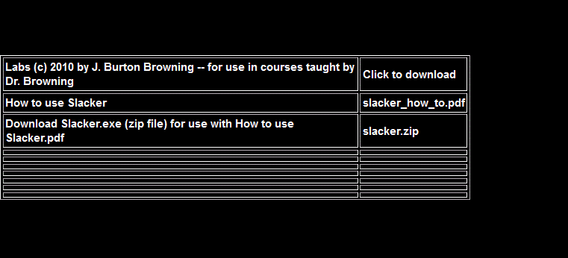
Item 12 – slacker.png
Second TrueCrypt file.
Slacker
Used to hide a file within another file’s slack.
Slack – Space associated by the file but not used.
C:/WINDOWS/system32/us.sys/
Notes:
The second item found within the TrueCrypt container is a screenshot of a website with instructions on how to use a piece of software called ‘Slacker’.
The software allows a user to hide a file within another files slack, making it invisible to anyone not looking for it.
File slack is space associated with a file, but is not actually used. This means it can be modified freely without causing any visible change to the file.

Slide 17
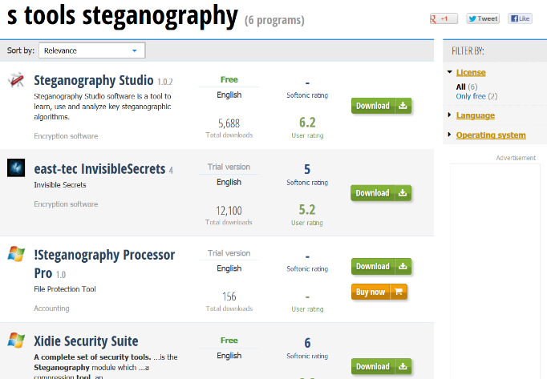
Item 13 – steg.png
Third TrueCrypt file.
Steganography - Used to hide a file within another file.
S-Tools – Well known Steganography tool.
C:/WINDOWS/system32/us.sys/
Notes:
The last item found within the TrueCrypt container is a screenshot of a web search for S-Tools steganography.
Steganography is the concealment of a message, image, or file within another message, image, or file.
S-Tools is a well known steganography tool, used to hide files within others.

Slide 18

Item 14 – goog.png
Hiding messages in audio files
Steganography - Used to hide a file within another file.
S-Tools – Supports .wav audio files
Found searching user internet history.
C:/Documents and Settings /Administrator/Internet History/
Notes:
The last piece of evidence found on the hard drive was a capture of a Google search on ‘hiding messages in audio files’.
This fits in with the previous item and the use of steganography, as S-Tools supports .wav audio files.

Slide 19
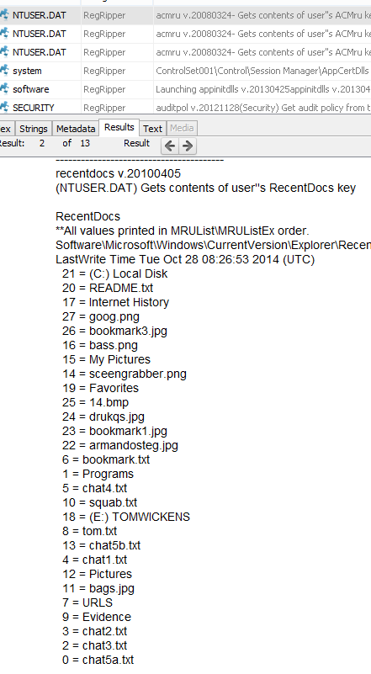
Further Leads
Slacker – Evidence in file slack.
Steganography – Evidence hidden within a file.
Recent Documents
Notes:
The last few items make it likely that further evidence has been hidden in file slack and using steganography.
There are files I suspect contain steganography on the hard drive, including an audio file and an image, but I was not able to find a password to prove this. The password could well have been hidden in a file’s slack, but I did not have time to fully check this.
The list here shows the user’s most accessed files and directories. The majority of these have already been covered in previous items, so the others could also contain further evidence.

Slide 20
Observations
Users of interest: Richie Beans, Patsy Perovski, Tony T, Derek B
All evidence found evolves around drug dealing and hiding of this evidence.
TrueCrypt container – Contained files of high importance to user.
Further evidence could likely be found.
Notes:
The key user’s mentioned within the case include Richie Beans, Patsy Perovski, Tony T and Derek B, who all likely have knowledge that would further aid the investigation.
All evidence found evolves around the dealing of drugs and hiding of this evidence.
Hiding images of steganography & slacker in a TrueCrypt container mean they were of high importance to the user, suggesting that the techniques have been used.
Further evidence could likely be found by looking through the slack of commonly accessed files to find a lead on the password used for steganography on the hard drive.

